Slide 1
PROGETTO SCIENCE
2016 - 2017

Slide 2
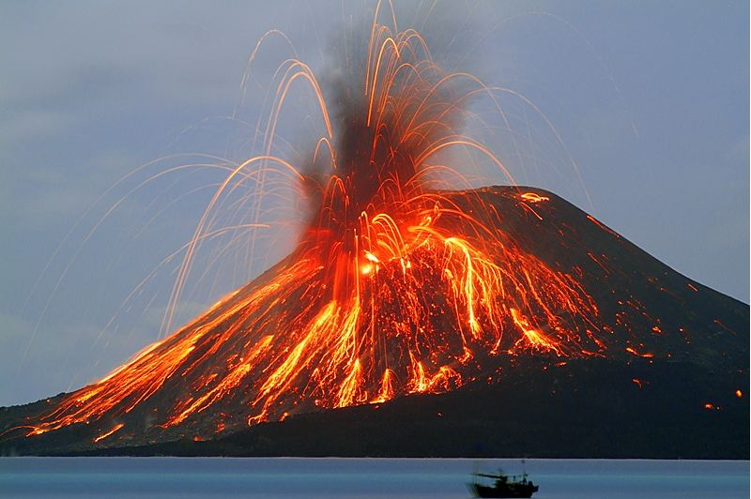
SARAH PEPE

Slide 3
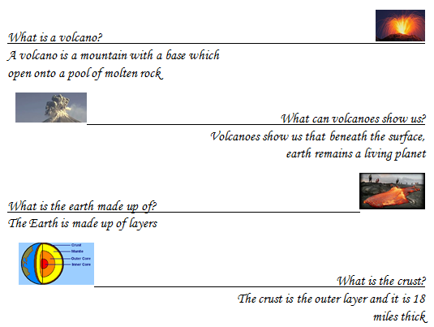

Slide 4
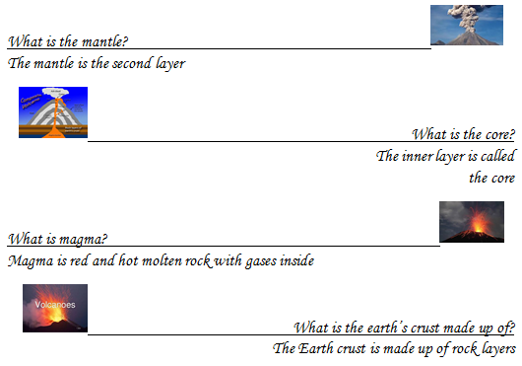

Slide 5
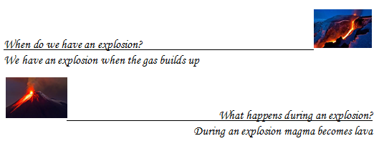

Slide 6
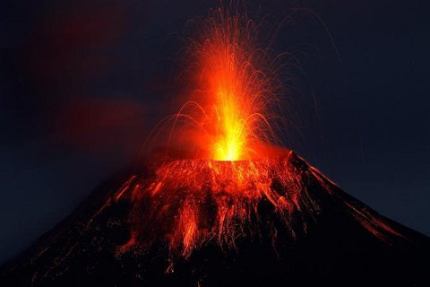
DAVID MAKNOUZ

Slide 7
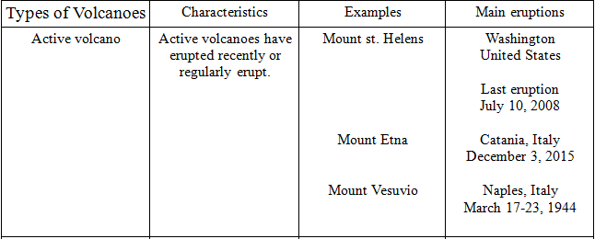

Slide 8
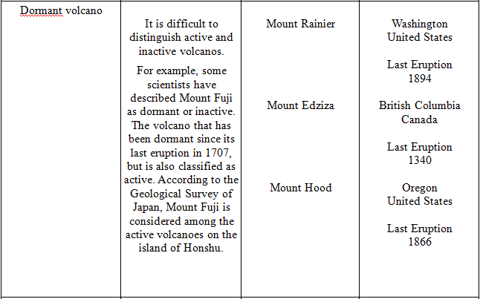

Slide 10
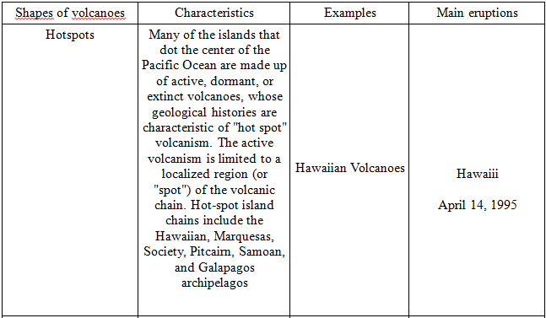

Slide 11
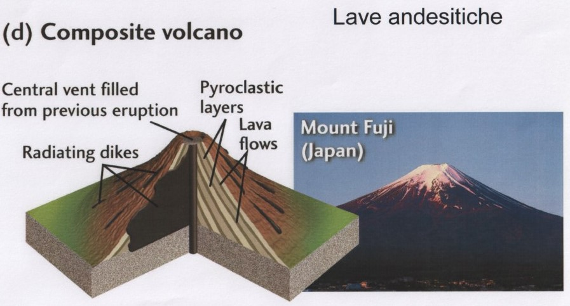

Slide 12
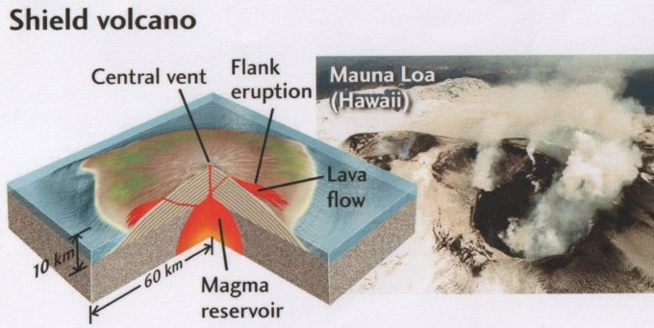

Slide 13
NOEMI DEIL

Slide 14
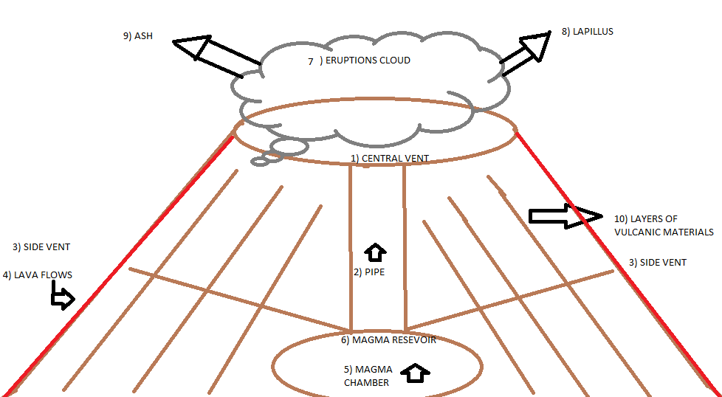
1)Central vent = Cratere centrale
2)Pipe = Camino
3)Side vent = Cratere laterale
4)Lava flows = Colata di lava
5)Magma chamber = Camera magmatica
6)Magma resevoir = Sacca magmatica
7)Eruption Cloud = Nube ardente
8)Lapillus = Lapillo
9)Ash = Cenere
9*) Bombs = bombe
10)Layers of volcanic
materials = strati vulcanici

Slide 15
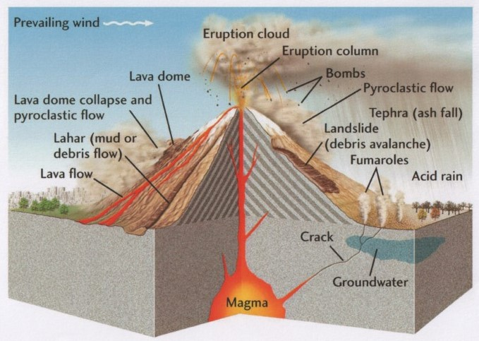

Slide 16
GLOSSARY - GLOSSARIO
Beneath = Sotto
Crust = Crosta
Surface = Superficie
Inner = Interno
Pool = Pozza
Huge = Enorme
Change = Cambiamento
Poisonous = Velenoso
Harmful = Dannoso
Deadly = Mortale
Earth = Terra
Core = Nucleo
Rock = Roccia
Layers = Strati
Plates = Placche
Floods = Inondazioni

Slide 17
Slopes = Pendii
Provide = Fornire
GeoThermal-Energy = Energia GeoTermica
Benefits = Benefici
Earthquake = Terremoto

Slide 18
YOSEF TOUITOU

Slide 19
SAINT HELEN ERUPTION

Slide 20
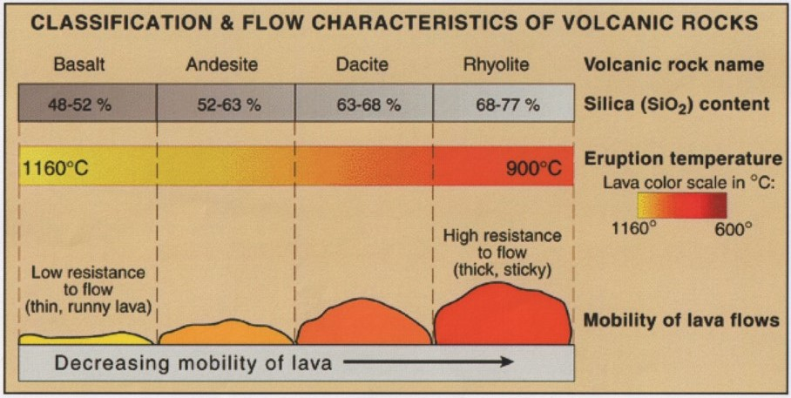

Slide 21
BOMBE VULCANICHE
Le bombe vulcaniche si formano quando la lava densa viene espulsa con violenza dal vulcano
Solidificandosi in volo forma dei frammenti che prendono la forma di grosse gocce.
> 64 mm

Slide 22
LAPILLI
Frammenti di bombe vulcaniche di dimensioni ridotte
12 – 64 mm

Slide 23
CENERE
Polvere di roccia vulcanica che si deposita a grandi distanze per mezzo delle nubi ardenti
< 12 mm

Slide 24
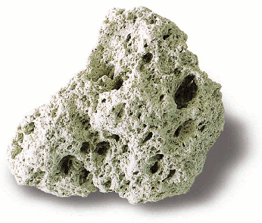
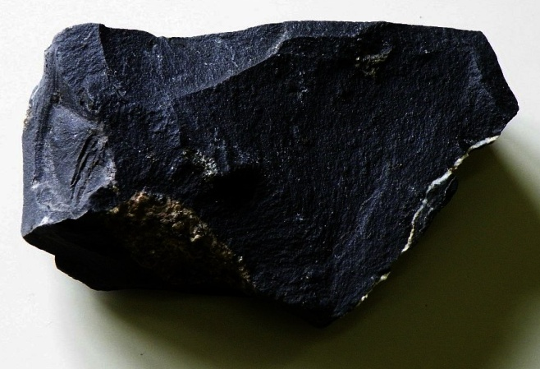
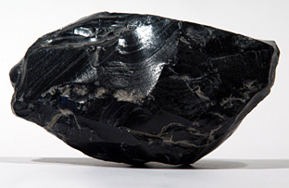
Quando la lava contiene molto gas si forma la pomice: una roccia molto leggera.
Il basalto è la roccia più abbondante nei fondali oceanici, il magma solidificandosi può organizzarsi in strutture simili.
L’ossidiana è un vetro vulcanico che si forma quando la lava liquida si raffredda molto velocemente a contatto con l’atmosfera o con l’acqua.

Slide 25
YOSSI KADOSH
VOLCANOES
What are the consequences of volcanic eruptions?
How can volcanic eruptions change the weather?
Which are the volcanic hazards? And benefits?

Slide 26
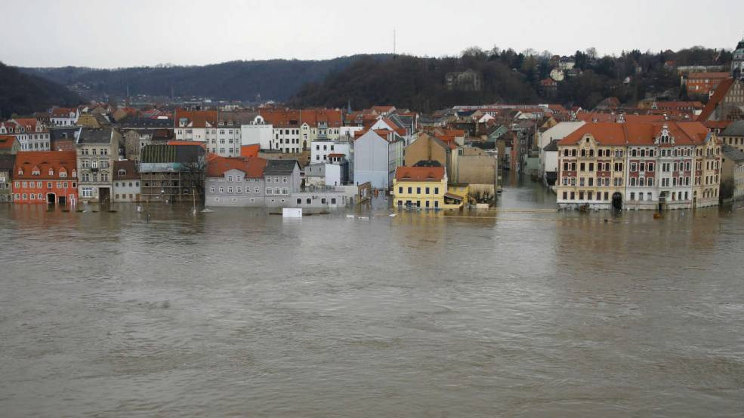
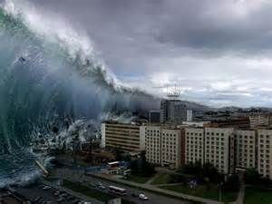
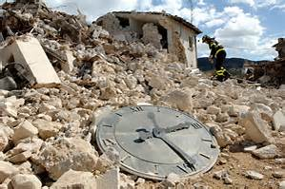
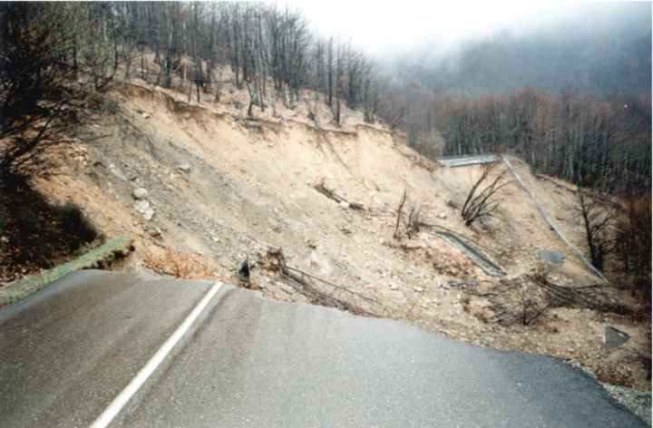
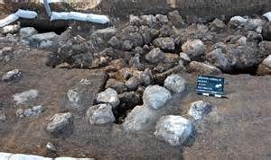
Consequences of volcanic eruptionS
TSUNAMIS
EARTHQUAKES
ROCK FALLS
FLOODS
MUD FLOWS
FLOODS
TSUNAMIS
MUD FLOWS
EARTHQUAKES
ROCK FALLS

Slide 27
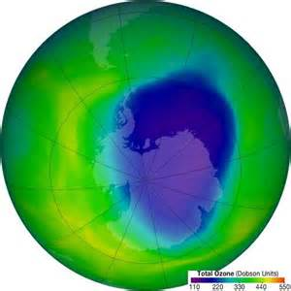
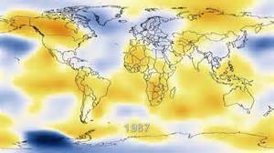
HOW CAN VOLCANIC ERUPTIONS CHANGE THE WEATHER?
Volcanic eruptions can damage the Earth’s hozone layer and consequently influence the weather wich becomes hotter or cooler.
hozone layer
influence the weather

Slide 28
VOLCANIC HAZARDS
Lava flows are extremely hot, they can cause severe damages and burn down vegetation and homes.
Most of the gases released in an eruption are composed by water vapor (relatively harmless), but volcanoes also produce other gases that can be dangerous, even deadly.

Slide 29
VOLCANIC BENEFITS
Volcanoes have created 80% of the Earth surface
We can use Geothermal-Energy
3) The cinder coming out from a volcano makes the soil more and more fertile.

Slide 30
COMPREHENSION CHECK

Slide 31
WHICH ARE THE CONSEqUENCES OF VOLCANIC ERUPTIONS?
$$×$$
$$√$$
$$×$$
TSUNAMI, FLOODS, MUD FLOWS, ROCK FALLS, ECLIPSE
TSUNAMI, OTHER ERUPTIONS, ROCK FALLS AND FLOODS
TSUNAMI, EARTHQUAKES, ROCK FALLS, FLOODS AND MUD FLOWS

Slide 32
Because the volcanIC ERUPTIONS can daMage the hozone layer and CONSEQUENTLY influence the...
$$×$$
$$×$$
$$√$$
WEATHER WHICH BECOMES COOLER
WEATHER WHICH BECOMES HOTTER
WEATHER WHICH BECOMES HOTTER OR COOLER

Slide 33
the gases released in an eruption ARE...
$$×$$
$$×$$
$$√$$
SOMETIMES DENGEROUS
HARMLESS
DENGEROUS, EVEN DEADLY

Slide 34
THE CINDER... MAKE THE SOIL ...
$$√$$
$$×$$
$$×$$
MORE AND MORE FERTILE
LESS FERTILE
AS FERTILE AS BEFORE THE ERUPTION

Slide 35
When a volcano erupts we can use ...
$$×$$
$$√$$
$$×$$
EOLIC ENERGY
SOLAR ENERGY
GEOTHERMAL-ENERGY

Slide 36
volcanOES HAVE CREATED ...
$$√$$
$$×$$
$$×$$
80% OF THE EARTH SURFACE
88% OF THE EARTH SURFACE
90% OF THE EARTH SURFACE

Slide 37
LAVA FLOWS ARE ...
$$×$$
$$×$$
$$√$$
DANGEROUS
EXTREMELY HOT
BOTH ANSWERS ARE CORRECT

Slide 38
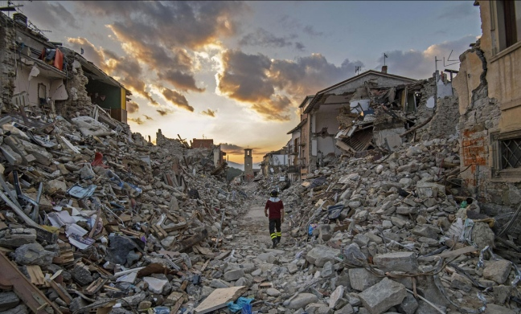
MOSHE SUETS

Slide 39
WHAT IS AN EARTHQUAKE?
The earthquake is a vibration of the Earth going from an “ipocenter” to an “epicenter”.
The vibrations are transmitted by waves.

Slide 40
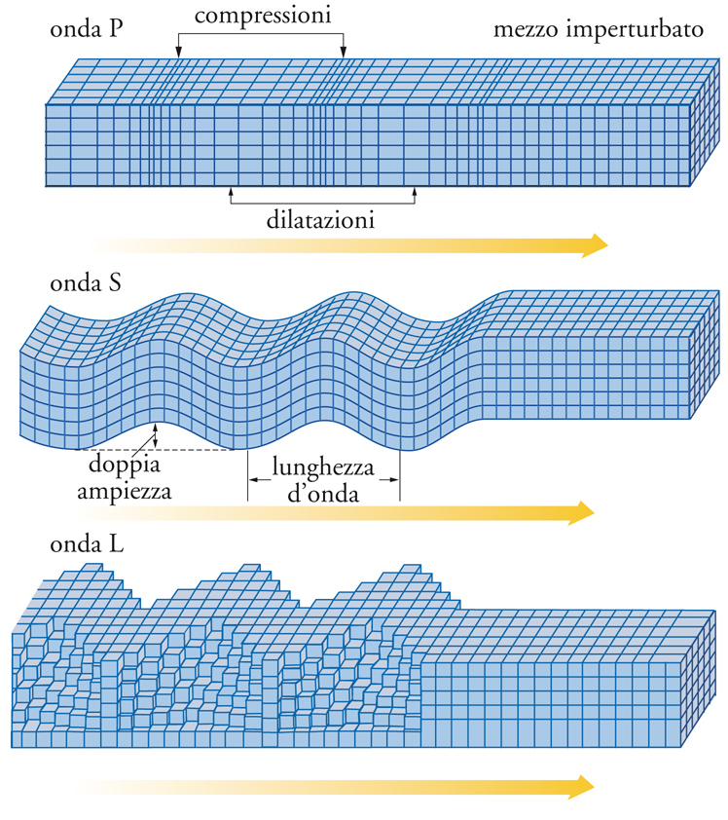
Seismic waves
Primary waves
Secondary waves
Longitudinal / Superficial waves

Slide 41
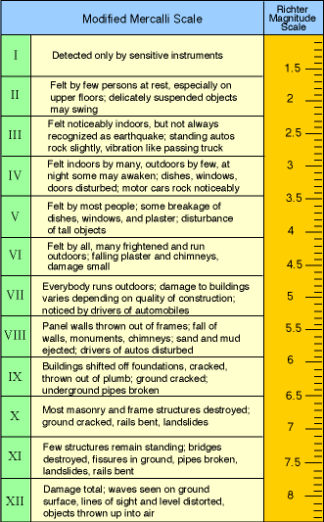
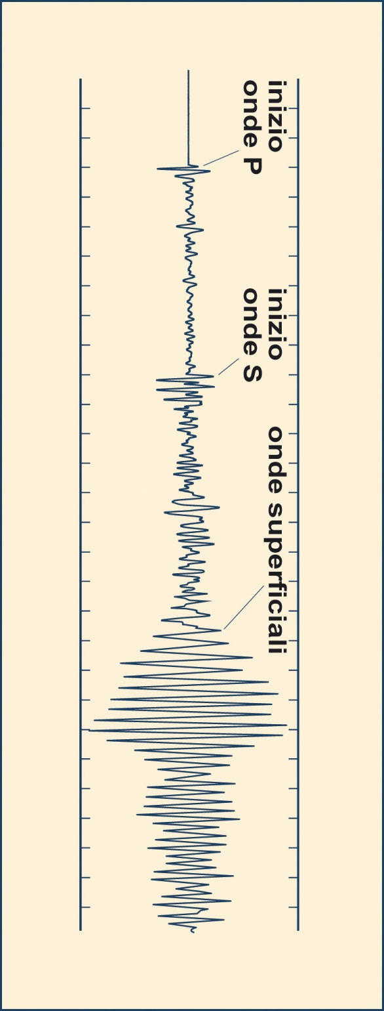
Seismic scale
Mercalli scale: represents the hazards
Richter scale: represents the magnitude

Slide 42
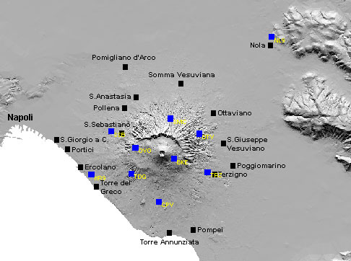
Osservatorio Vesuviano
SISMOGRAPH POSITION
NAME OF THE CITIES

Slide 43
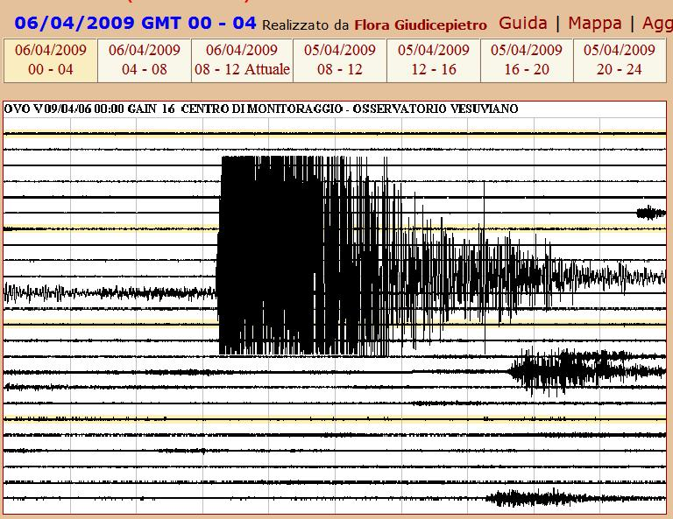
SISMOGRAMMA

Slide 44
GRACE SARAH
THE PRESENT SIMPLE

Slide 45
When Can we Use The Present Simple?
The simple present tense, is used for things that are always true
(for scientific truths)

Slide 46
How can we form the present simple?
We can form the present simple using the base form of the infinitive.
In the third person we add “S”.

Slide 47
SPELLING
For verbs that end in O-CH-SH-SS-Z-Y we add “ES” in the third person.
Example
Go Goes
Catch Catches
Wash Washes
Kiss Kisses
Fix Fixes
Buzz Buzzes

Slide 48
For verbs that end in a consonant + Y, we remove the Y and we add “IES”.
Example
Marry Marries
Study Studies
Carry Carries
Worry Worries

Slide 49
For verbs that end in a vocal + Y, we just add “S”
Example
Play Plays
Enjoy Enjoys
Say Says

Slide 50
QUESTION S
IN THE PRESENT SIMPLE
DO or DOES are the words used in order to make a basic question

Slide 51
DO/DOES | SUBJECT | VERB | THE REST OF THE SENTENCE
DO | VOCANOES | CAUSE | DISASTERS?

Slide 52
NEGATIVE SENTENCES
DON’T or DOESN’T are the words used in order to make a negative sentence.

Slide 53
SUBJECT | DON’T/DOESN’T | VERB | THE REST OF THE SENTENCE
VOLCANOES | DON’T | CAUSE | ONLY DISASTERS, BUT THEY CAN ALSO PROVIDE BENEFITS

Slide 54
THE END

