Slide 1
.
HEALTHY GROWTH
Sarah e Leo (Salt and Pepper)

Slide 2
introduction
A healthy diet helps your growth!

Slide 3
RULES FOR A HEALTY GROWTH:
We need cereal or bakery products milk or yoghurt and fruits.
Split up daily calories intake into 5 meals:
15% breakfast.
5% midmorning.
40% lunch.
10% in the afternoon.
30% at supper.
Reduce salt and salty foods.
Morning
glossary
Supper cena
Bakery products prodotti da forno
Midmorning metà mattinata
Intake apporto nutritivo
Reduce ridurre

Slide 4
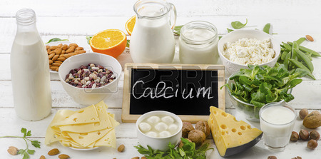
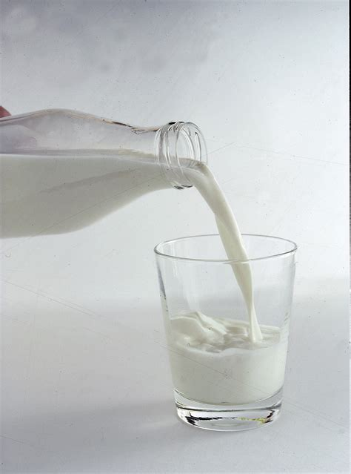
Calcium:
CALCIUM:
It’s essential for building strong bones and teeth.
glossary
Bones ossa
Strong forte/resistente
Glass bicchiere
Board lavagna

Slide 5
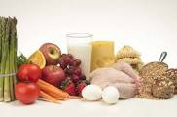
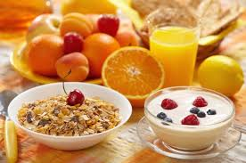
Mnerals:
MINERALS:
Help the body to convert food into energy.
glossary
Convert trasformare

Slide 6
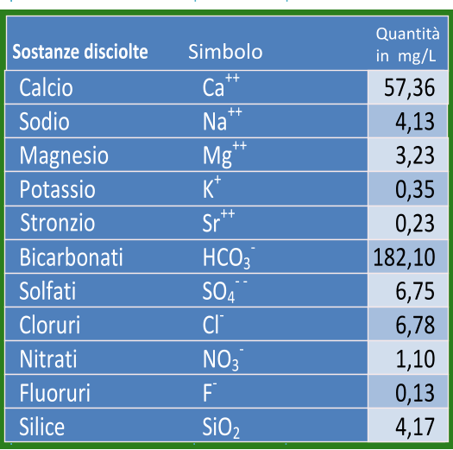
Sali minerali
Costituiscono l’1% del nostro corpo e hanno funzione plastica e regolatrice. (è molto importante avere del calcio ne corpo perché è molto facile rompersi le ossa).
Sono indispensabili i cosi detti:”OLIGOELEMENTI” elementi chimici che devono essere assunti come; iodio,fluoro,cobalto,cromo e molibdeno.
Gli troviamo negli; ortaggi,frutta e latte.
vocabolario
Corpo body
Importante important
Indispensabili indispensable
Oligoelementi trace elements

Slide 7
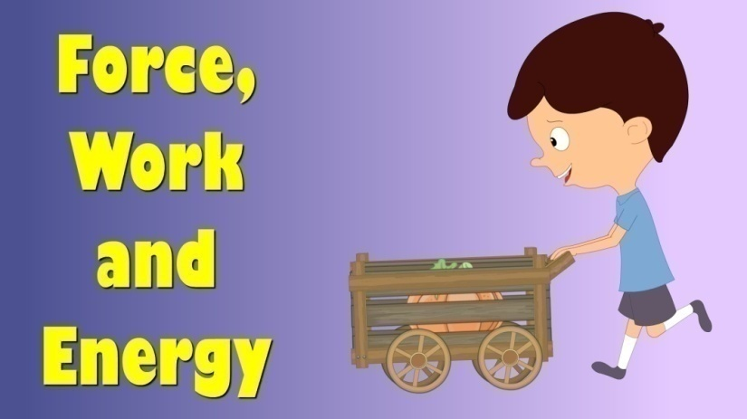
energy
ENERGY:
How much energy do we need? People need different amounts of energy: teenagers need a lot of energy.
glossary
Amounts quantità

Slide 8
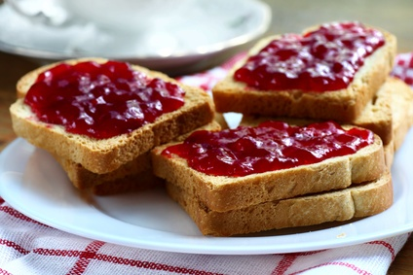
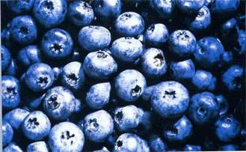
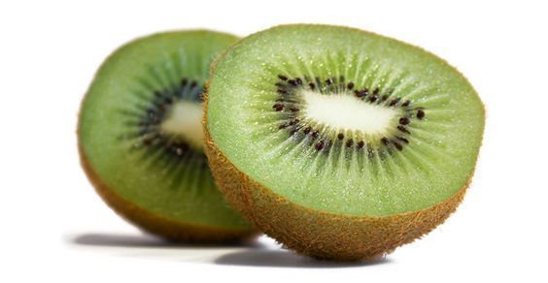
MENU
BREAKFAST
Have a healthy breakfast:
toast with jam and a small kiwi or two handfuls of blueberries.

Slide 9
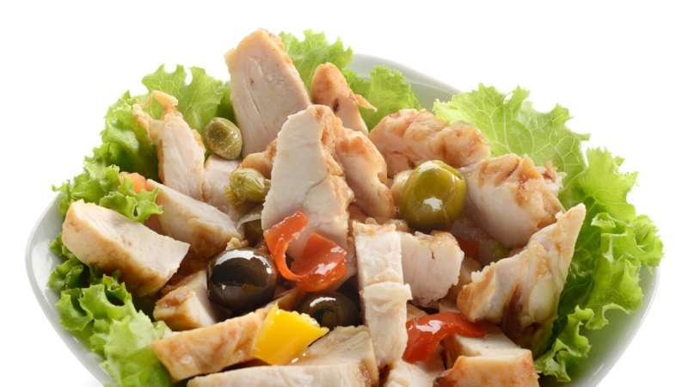
lunch
Prepare a chicken salad. Cut a tomato into small pieces and add to your salad.

Slide 10
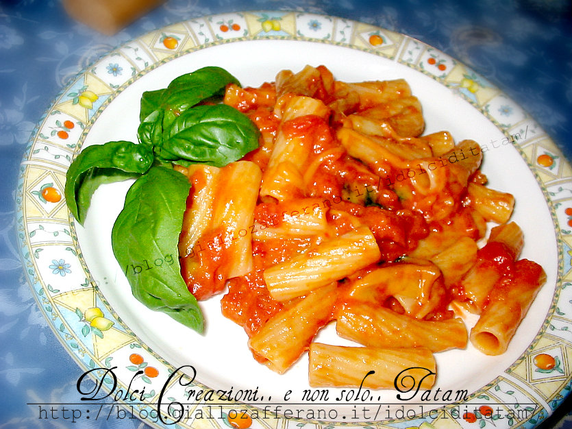
dinner
Make your own pasta: make a tomato sauce and add mozzarella cheese.

Slide 11
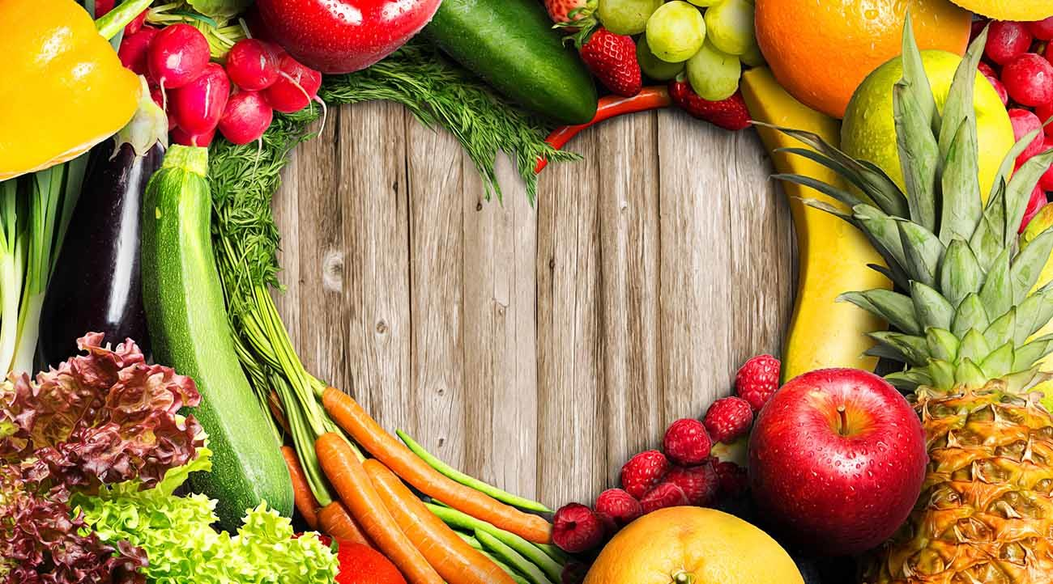
THE END

Slide 12
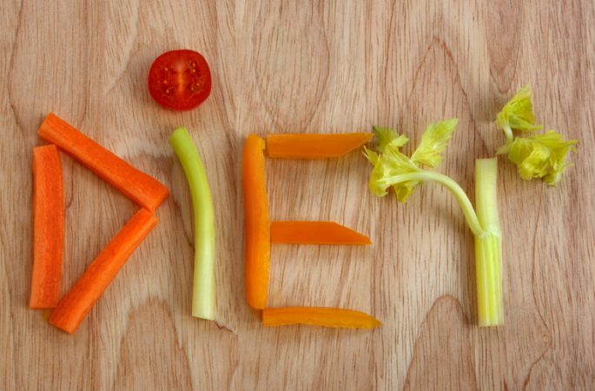
ELIAH & MICHAL II MEDIA

Slide 13
GLOSSARY
healthy = sano
diet = alimentazione
Contains = contiene
carbohydrates = carboidrati
proteins = proteine
fats = grassi
nutrients = sostanze nutritive
to perform properly = agire in modo corretto
KNOW YOUR NUTRIENTS
A healthy diet contains :
Carbohydrates, proteins, fats, vitamins, minerals, fibre, and water.
Food gives us nutrients which help the body preform properly.

Slide 14
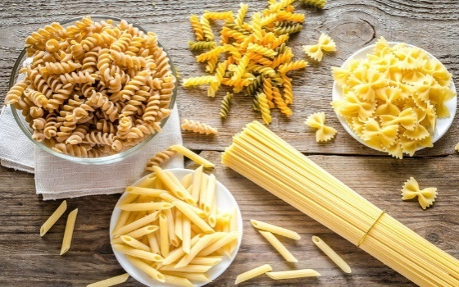
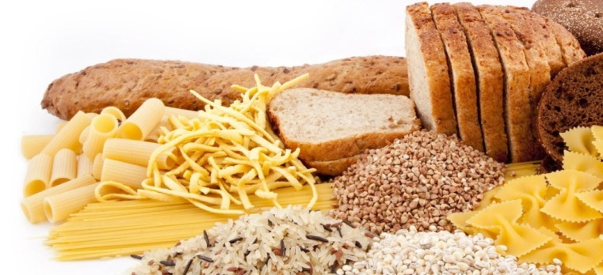
GLOSSARY
most = la maggior parte
types = tipi
complex = complesso
simple = semplice
CARBOHYDRATES
Most of the energy we need comes from carbohydrates.
There are 2 types of carbohydrates:
1) simple
2) complex

Slide 15
CARBOIDRATI
I carboidrati costituiscono il 6% del nostro corpo e sono la nostra fonte di energia principale. La quantità rimasta di zuccheri si accumula sotto forma di grasso
DOVE LI TROVIAMO?
PANE, PASTA, CEREALI…

Slide 16
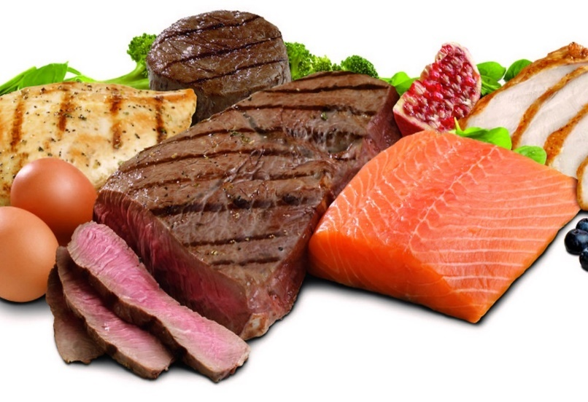
glOssary
development = sviluppo
growth = crescita
to contain = contenere
cannot be made by the body = non vengono prodotte dal corpo.
PROTEINs
We need proteins for growth and development. Babies and children need more proteins than adults. Proteins contains important amino acids which cannot be made by the body.

Slide 17
PROTEINE
Le proteine costituiscono circa il 18% del nostro corpo servono per sviluppare i muscoli e svolgono la funzione:
plastica: modella il tessuto muscolare
costruttiva: curare i microtraumi e ingrandire le fibre muscolari
DOVE LI TROVIAMO?
uova, carne, pesce, latte e derivati …

Slide 18
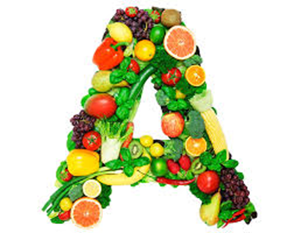
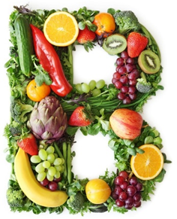
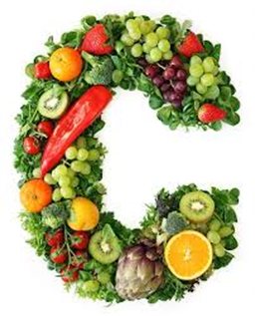
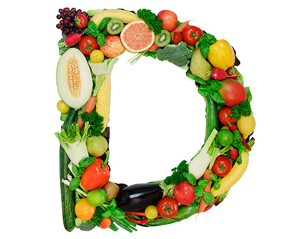
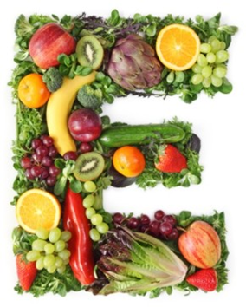
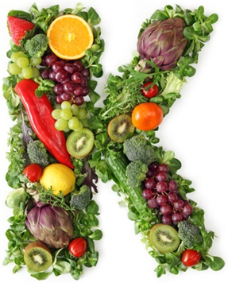
glossary
Vital = vitale
vitamins
The name vitamin comes from the word vital. There are different kinds of vitamins :
A,B,C,D,E and K

Slide 19
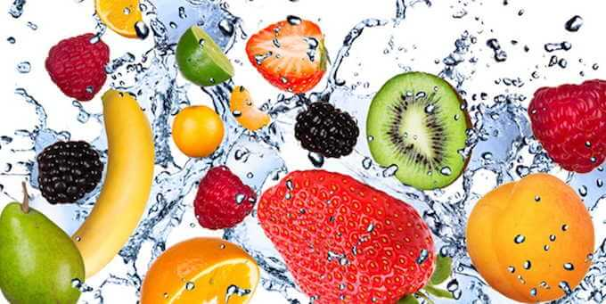
VITAMINE
Sono sostanze organiche e svolgono 2 funzioni:
Regolatrice: regola la quantità di zuccheri nel sangue
Protettiva: svolge il sistema immunitario insieme ai globuli bianchi
È meglio mangiare la frutta e la verdura cruda e non cotta.
Dove si trova?
Frutta e ortaggi

Slide 20
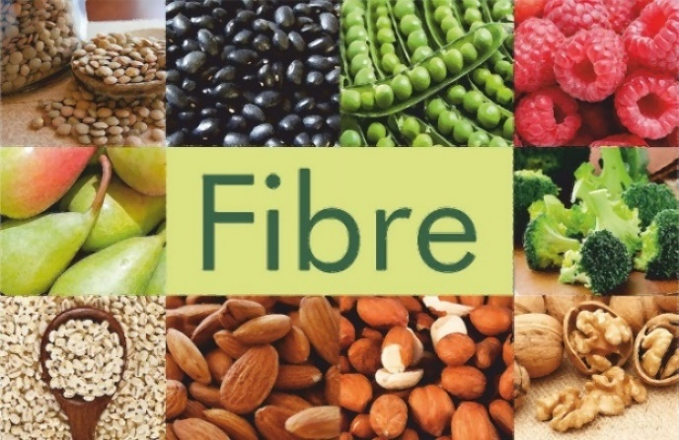
GLOSSARY
plants = piante
to pass = passare
Through = attraverso
Undigested = non assimilato
types = tipi
soluble = solubile
insoluble = insolubile
FIBRE
Fibre comes from plants and
Passes through the body
Undigested. There are two
Types of fibre:
- Soluble and
- Insoluble

Slide 21
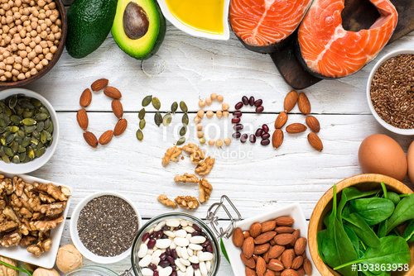
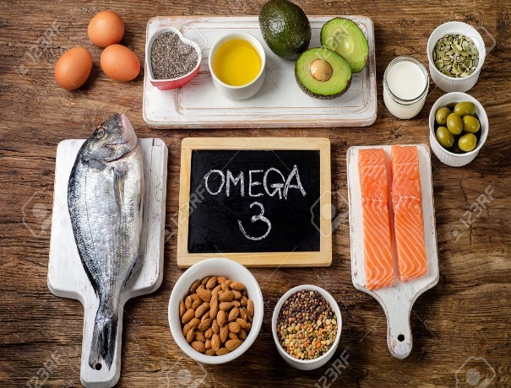
fats and omega 3
Omega fats are essential to health and we can find them in oily fish.
They improve heart health and brain function
glossary
omega fats = grassi
Essential = essenziale
helath = sano
find = trova
improve = migliorare
Heart = cuore
brain = cervello
Function = funzione

Slide 22
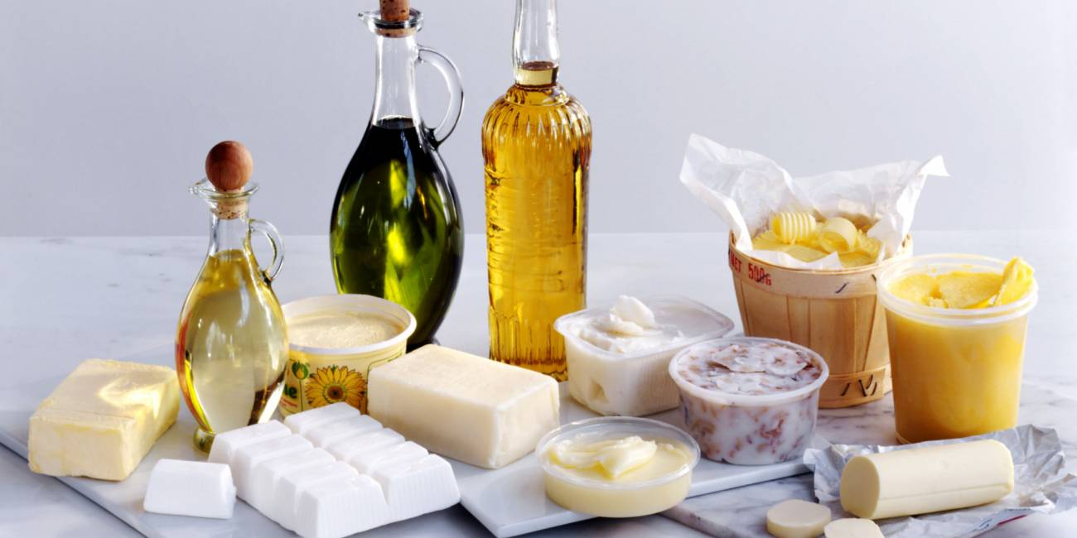
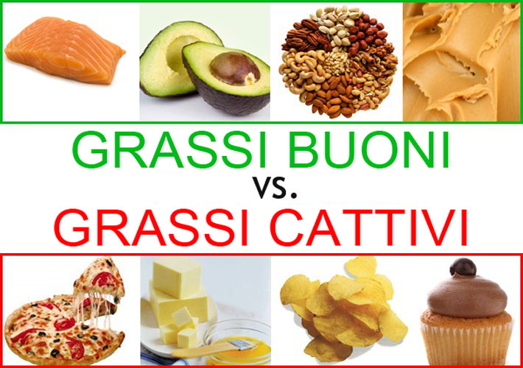
grassi
I grassi contengono il 10% del nostro corpo e svolgono la funzione energetica. I grassi hanno il doppio dell’energia degli zuccheri e dei carboidrati.

Slide 23
EAT MORE FRUIT AND
VEGETABLES
REDUCE THE NUMBER OF UNHEALTHY SNACKS AND CHOOSE HEALTHY ALTERNATIVES

Slide 24
glossary
low- fat = a basso contenuto di grassi
dairy products = latticini
whole wheat flour = farina di frumento integrale
reduce =ridurre
balance = equilibrare
A HEALTHY DIET HELPS YOU GROW
Choose fruit, low-fat dairy products and whole wheat flour foods.
Reduce the intake of snacks hightin sugar or in saturated fats that can lead to weight excess.
Always read foods nutritional information.
Balance snacks with other daily meals

Slide 25
glossary
Grow = crescere
Develop = svilupparsi
Risk = rischio
chronic diseases = malattie croniche
EAT MORE FRUIT AND VEGETABLES
Eating more fruit and vegetables every
day helps children and teenagers grow
healthy and develop normally and reduce
the risk of developing chronic diseases.
It’s important to teach children to eat fruit
and vegetables at each meal. Main goal:
Five portions of fruit and vegetables a
day.
Fresh fruit is a healthy alternative snack.

Slide 26
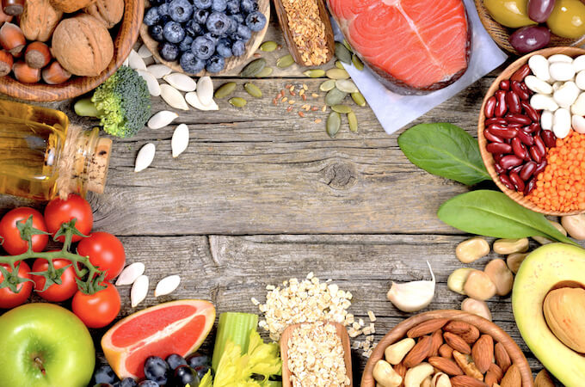
The end

Slide 27
RULES FOR a healthy growth and aims of the research centers
JONATAN AND CHANNA (B & B)

Slide 28
Introduction
B and B would like to teach you how to be healthy.

Slide 29
BMI
BMI = BODY MASS INDEX:
INDICE DI MASSA CORPOREA
(it compares your weight to your height)
BMI = weight
height²
GLOSSARY:
Weight = peso
Height = altezza
BMI | CONDIZIONI
<16,5 | GRAVE MAGREZZA
16 – 18,49 | SOTTOPESO
18,5 – 24,99 | NORMAPESO
25 – 29,99 | SOVRAPPESO
30 – 34,99 | OBESITA’ CLASSE 1
35 – 39,99 | OBESITA’ CLASSE 2
>41 | OBESITA’ CLASSE 3
Il bmi è la relazione tra l’altezza e con il peso, si ottiene dividendo il peso in kg e con il quadrato dell’altezza in metri

Slide 30
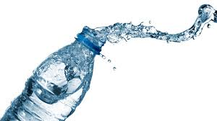
CHOOSE WATER As A DRINK
GLOSSARY:
Choose = scegliere
Rather than = piuttosto che.
Drink water is vital.
Drink frequently during the day.
An alternative to water can be sugar- free juices.
Choose fresh fruit rather than fruit juices.

Slide 31
ACQUA
L’acqua è una sostanza molto fondamentale per la vita, quasi tutte le reazioni chimiche si svolgono nell’ acqua. È l’unico nutriente che passa attraverso l’apparato nutriente senza subire formazioni.
Dove la troviamo? In quasi tutti gli elementi.

Slide 32
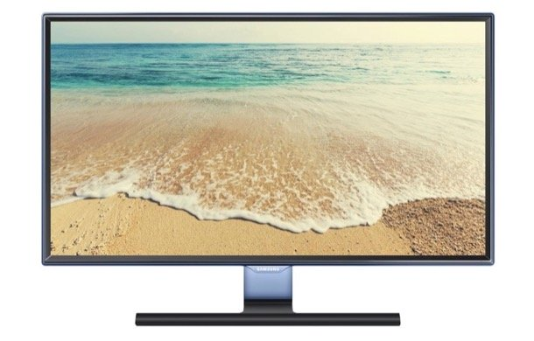
TURN OFF TELEVISION AND COMPUTER AND PLAY OUTSIDE
Sedentary life (watching TV, surfing the internet, playing videogames), promotes heavy and obesity in teenagers.
Teenagers shouldn’t spend more than two hours a day watching TV and playing videogames.
Teenagers should play outside.
GLOSSARY:
Choose = scegliere.
Should = dovrebbero.
Outside = fuori, all’aperto.
Sedentary life = vita sedentaria.

Slide 33
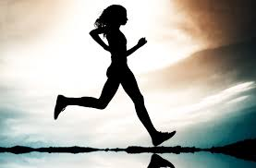
Take physical exercise
Regular physical exercise plays an important role in teenagers’ healthy growth, development and psycho physical well-being.
Teenagers should take at least 30 minutes, every day physical exercise.
Parents should encourage their children to take regular physical exercise.
GLOSSARY:
healthy = sano.
healthy growth = crescita sana.
development = sviluppo.
Well- being = benessere
Should = dovrebbero
Least = minimo

Slide 34
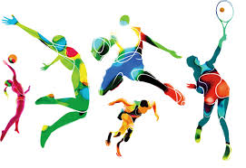
AIMS OF THE RESEACH CENTER FOR GROWTH DISORDERS
Promote education programmes to prevent childhood obesity
Help children and their family make healthy food choices.
Promote physical activity among children and their parents.
Treatment of growth disorders, by monitoring children’s height and weight.
GLOSSARY:
following = seguente.
through = attraverso.
Aims = scopi.
Growth disorders = disturbi della crescita.
Treatment = cura.

Slide 35
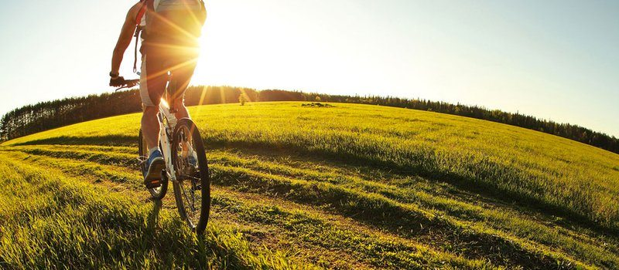

Slide 36
The end

